Slide 1

Introduction to IT and ITES Industry
Product-Based vs. Services-Based Companies, NASSCOM, STPI, and Global IT Projects

Slide 2
What is IT and ITES?
- IT: Information Technology
- ITES: IT-Enabled Services
- IT focuses on software & hardware
- ITES includes BPO, KPO, and LPO
- Growth driven by digitalization
- Key role in global economy

Slide 3
Product vs. Services Companies
- Product: Develop own software/hardware
- Examples: Microsoft, Google
- Service: IT solutions for clients
- Examples: TCS, Infosys
- Product: Higher R&D investment
- Service: Client-based revenue model

Slide 4
NASSCOM: Industry Body
- National Association of Software & Services
- Represents India's IT-BPM industry
- Helps policy-making & innovation
- Focus on skill development
- Encourages global collaborations
- Organizes IT summits & reports

Slide 5
STPI: Software Technology Parks
- Software Technology Parks of India
- Supports software exports
- Provides infrastructure & incubation
- Tax benefits for IT companies
- Promotes startups & innovation
- Key to India's IT growth

Slide 6
Latest IT Projects
- AI & Machine Learning in Healthcare
- Cloud computing transformations
- Blockchain for secure transactions
- 5G technology advancements
- Smart cities & IoT adoption
- Cybersecurity & data privacy initiatives

Slide 7
IT & ITES Market Trends
- Rapid cloud adoption
- AI & automation growth
- Increased cybersecurity focus
- Expanding remote workforce
- Rise of data-driven decisions
- Growing demand for IT talent

Slide 8
Major IT Hubs
- India: Bengaluru, Hyderabad, Pune
- USA: Silicon Valley, Seattle
- Europe: London, Berlin
- China: Beijing, Shenzhen
- Emerging hubs: Vietnam, Poland
- IT clusters drive innovation

Slide 9
Impact of Emerging Tech
- AI: Intelligent automation
- IoT: Smart devices
- Cloud: Scalable solutions
- Blockchain: Secure transactions
- 5G: Faster connectivity
- Quantum computing: Future potential

Slide 10
Govt Initiatives for IT
- Digital India Program
- Make in India
- IT SEZs & incentives
- Startup India support
- NASSCOM’s skill programs
- Global collaboration efforts

Slide 11
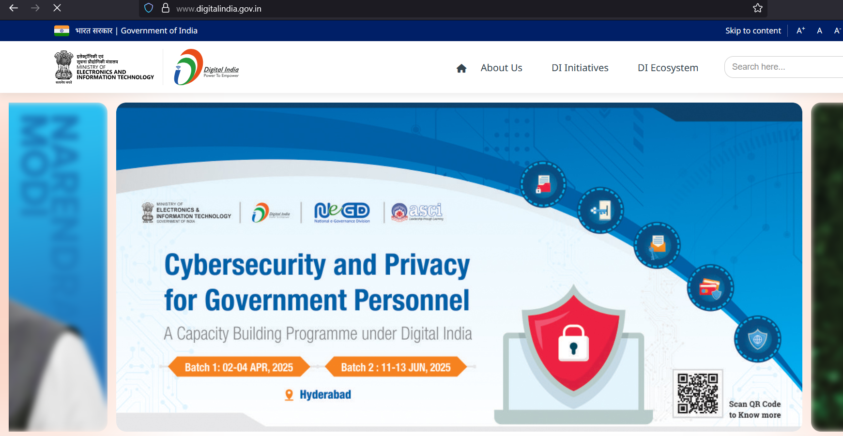

Slide 12
Govt Initiatives for IT
- Digital India Program
- Make in India
- IT SEZs & incentives
- Startup India support
- NASSCOM’s skill programs
- Global collaboration efforts

Slide 13
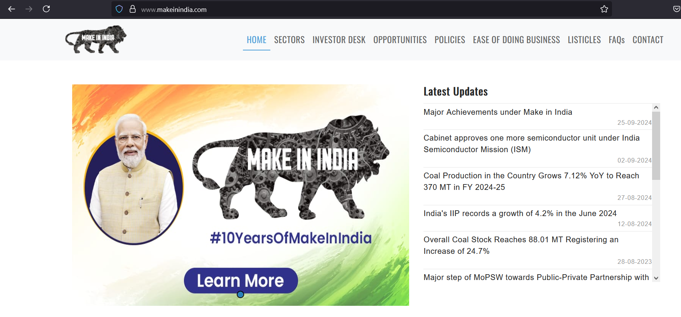

Slide 14
Successful IT Projects
- Aadhaar (India’s digital ID)
- Google’s AI-driven search
- Amazon AWS cloud expansion
- Tesla’s self-driving tech
- Paytm’s fintech revolution
- OpenAI’s ChatGPT & AI models

Slide 15
Future of IT & ITES
- AI & ML growth continues
- Cybersecurity challenges increase
- More automation & robotics
- Expansion of remote work
- Tech-driven economies
- Global IT talent demand rises

